Slide 1
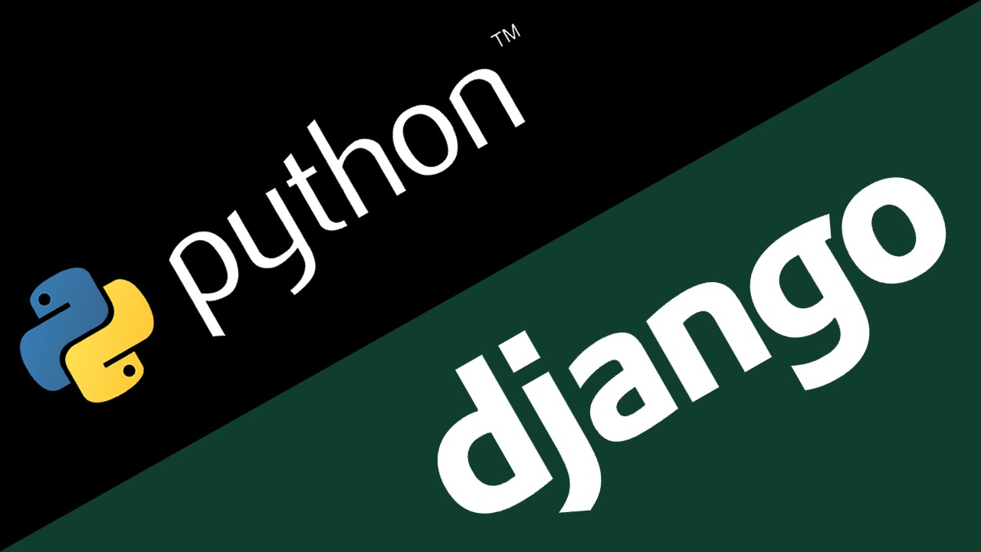
Django

Slide 2
Some Links
Project on Github: https://github.com/Zotzy/DjangoWorkshop
Django Documentation: https://docs.djangoproject.com/en/1.10/intro/tutorial01/

Slide 3
Flask vs Django
Flask is more of what we call a "micro" web framework. It is much "lower level" than Django is. This allows for more customization and control for the developer. Django is much more of a higher-level framework, and imposes a set structure on the developer.
Thus, with Flask you can create systems your way, which is probably not most efficient, fastest, or secure way. With Django, you are a bit more constrained, but you are going to most likely do it the best way possible.

Slide 4
django-admin startproject mysite
mysite/ - Simple container, Call whatever you want. manage.py - Lets you interact with your project via the command line. mysite/ - Actual project directory. __init__.py - Tells python this is a Python package. settings.py - Settings for the project. urls.py - URL rules. Django docs aptly describes as your table of contents. wsgi.py - WSGI magic begins here. Worry about this when it comes time to actually deploy to a server.

Slide 5
Now when you cd into mysite/
mysite/ migrations/ __init__.py admin.py apps.py models.py tests.py views.py

Slide 6
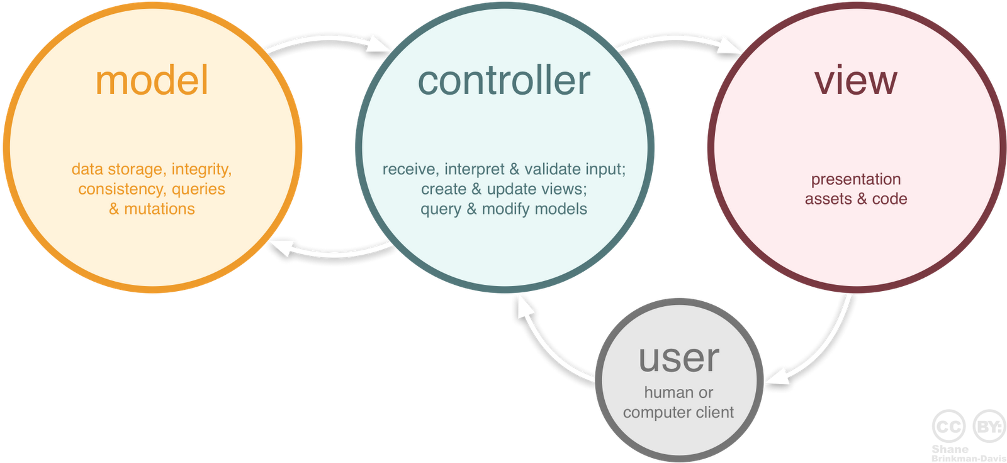
MVC Design Pattern

Slide 7
It’s more like MTV
VIEW
TEMPLATE

Slide 8
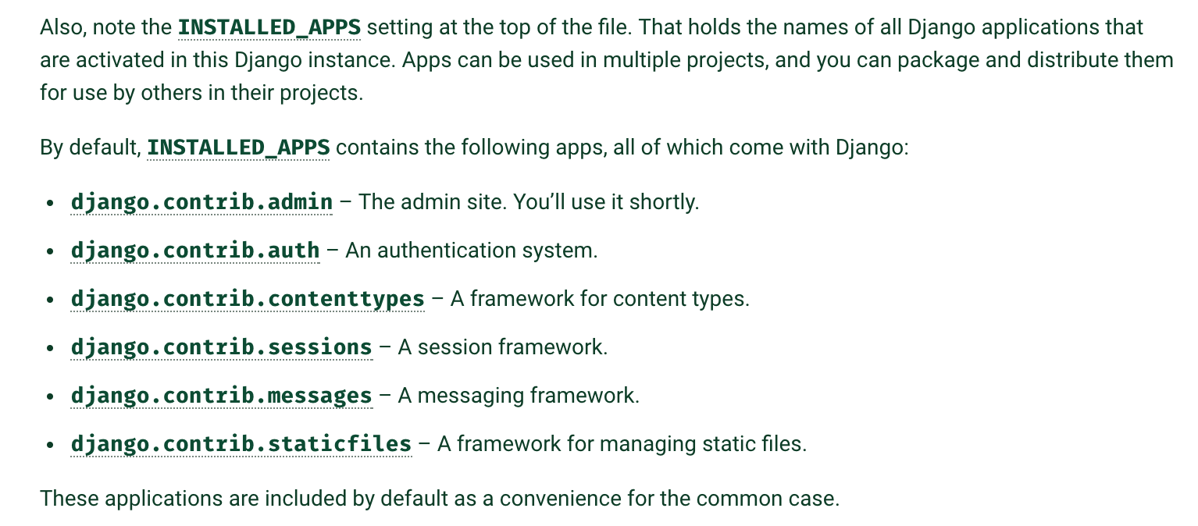
Perks of Django: Reusability, Apps, and DRY
django.contrib.admin - admin site
django.contrib.auth - an authentication system
django.contrib.contenttypes - framework for content types
django.contrib.sessions - a session framework
django.contrib.messages - a messaging framework
django.contrib.staticfiles - a framework for managing static files
Notes:
Reusability is the way of life in Python. The Python Package Index (PyPI) has a vast range of packages you can use in your own Python programs. Check out Django Packages for existing reusable apps you could incorporate in your project. Django itself is also just a Python package.

Slide 9
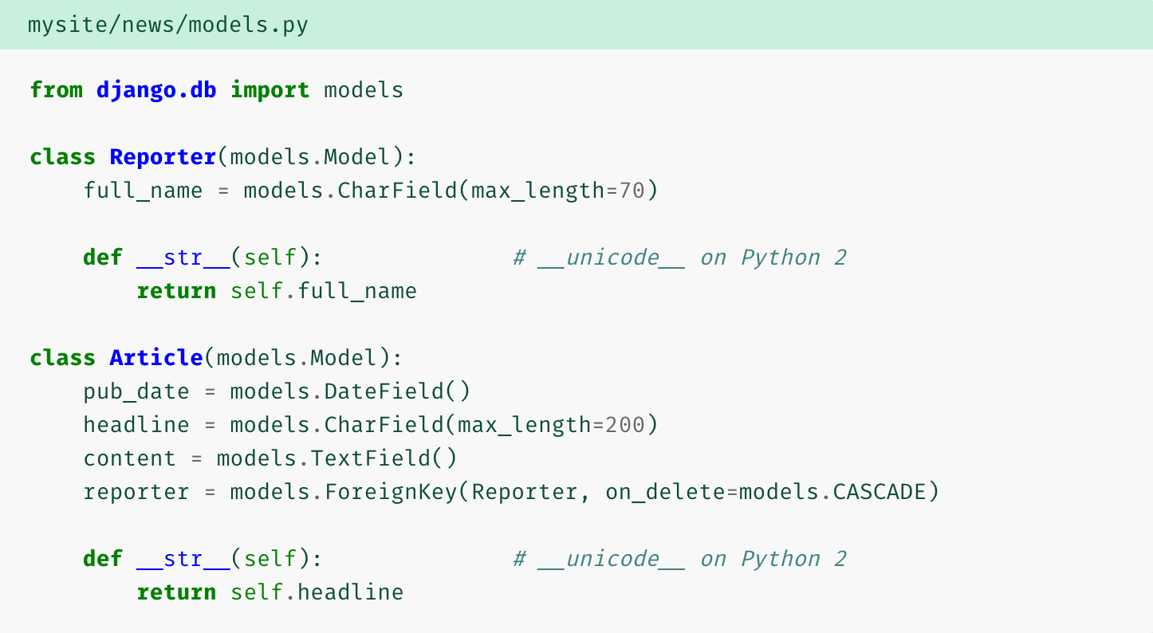
Perks of Django: Models
Although you can use Django without a database, it comes with an object-relational mapper in which you describe your database layout in Python code.

Slide 10
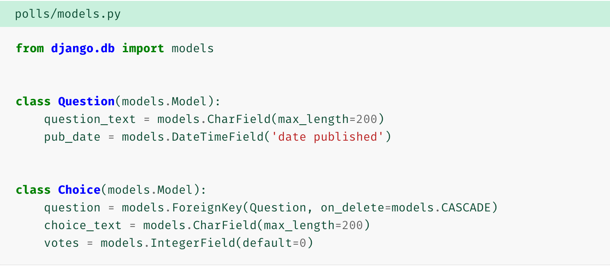
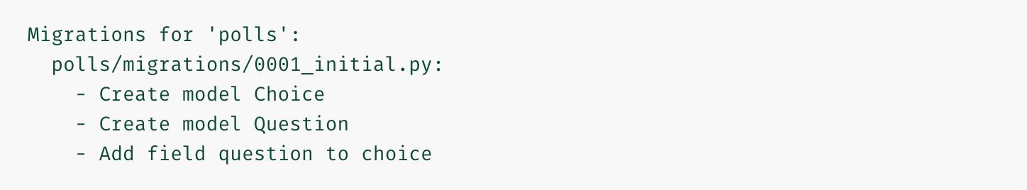
Perks of Django: Models Part II

Slide 11
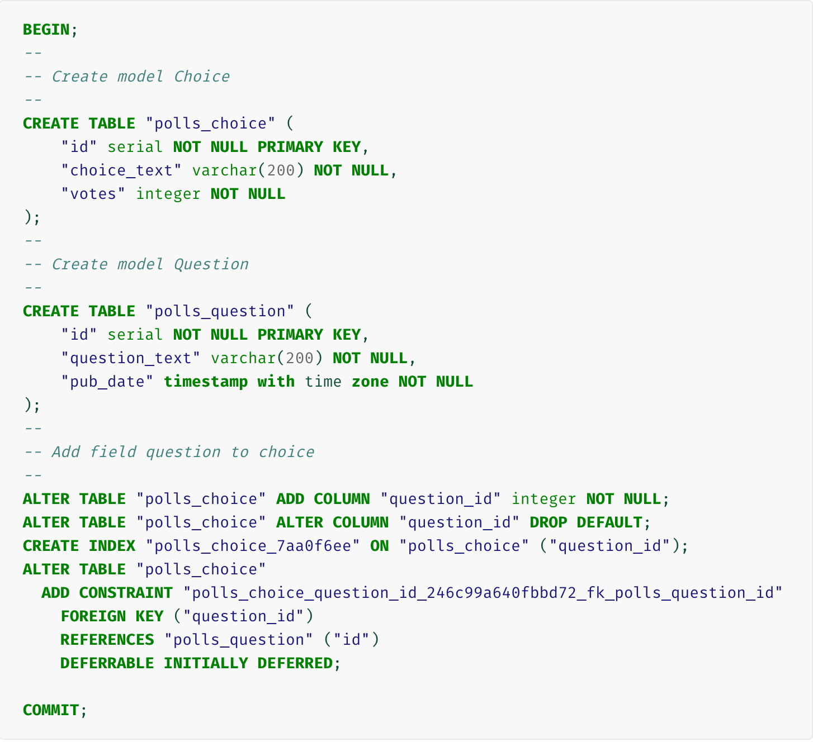
Perks of Django: Models Part III

Slide 12
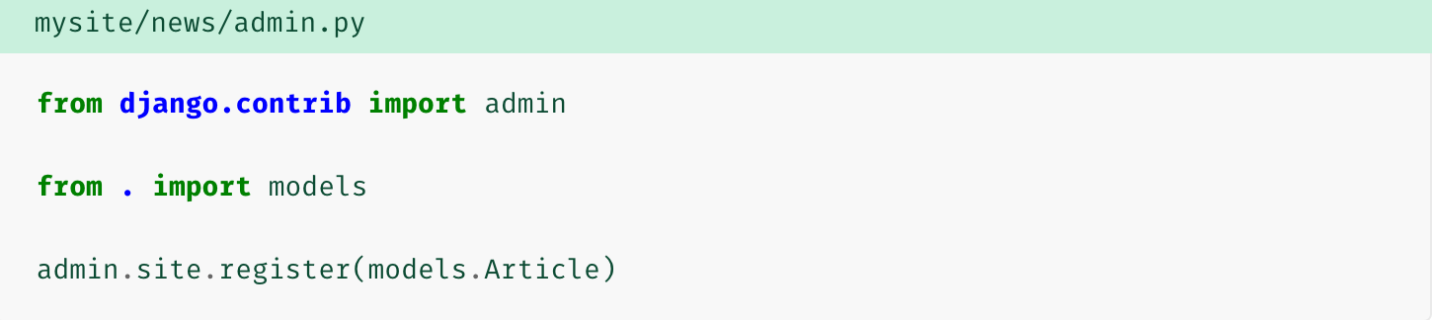
Perks of Django: Admin Interface
“A dynamic admin interface: it’s not just scaffolding – it’s the whole house”
Django can automatically create a professional, production ready administrative interface – a website that lets authenticated users add, change and delete objects.

Slide 13
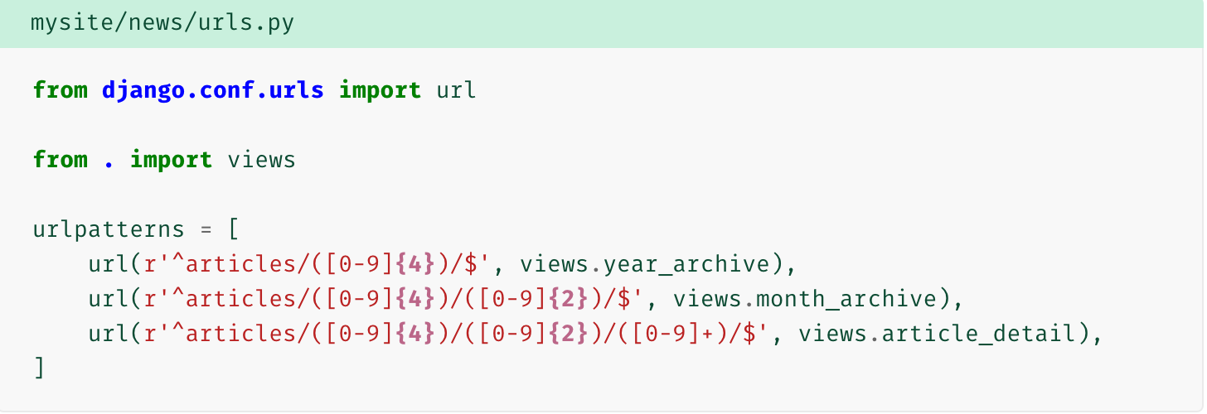
Perks of Django: URL routing
The main project has a urls.py file that dictates the URLs that lead to the apps, and then the apps themselves have their own urls.py, that dictates URLs from there.
For example, if a user requested the URL “/articles/2005/05/39323/”, Django would call the function news.views.article_detail(request, '2005', '05', '39323')

Slide 14
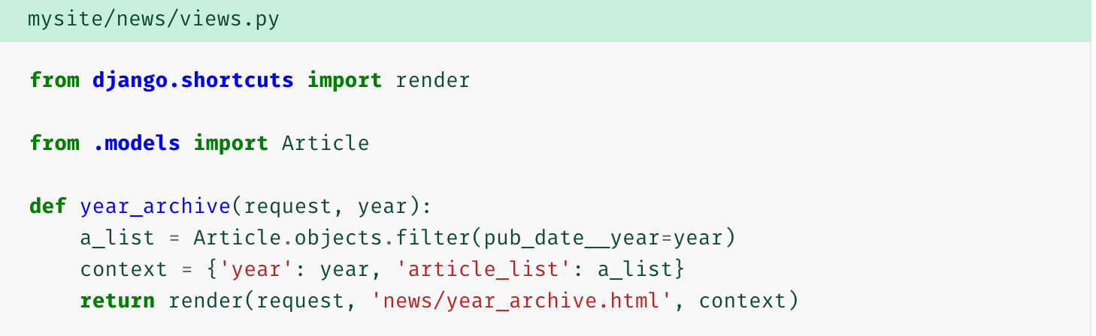
Perks of Django: Views
Each view is responsible for doing one of two things: Returning an HttpResponse object containing the content for the requested page, or raising an exception such as Http404. The rest is up to you.
Generally, a view retrieves data according to the parameters, loads a template and renders the template with the retrieved data.
The render() function takes the request object as its first argument, a template name as its second argument and a dictionary as its optional third argument. It returns an HttpResponse object of the given template rendered with the given context.

Slide 15
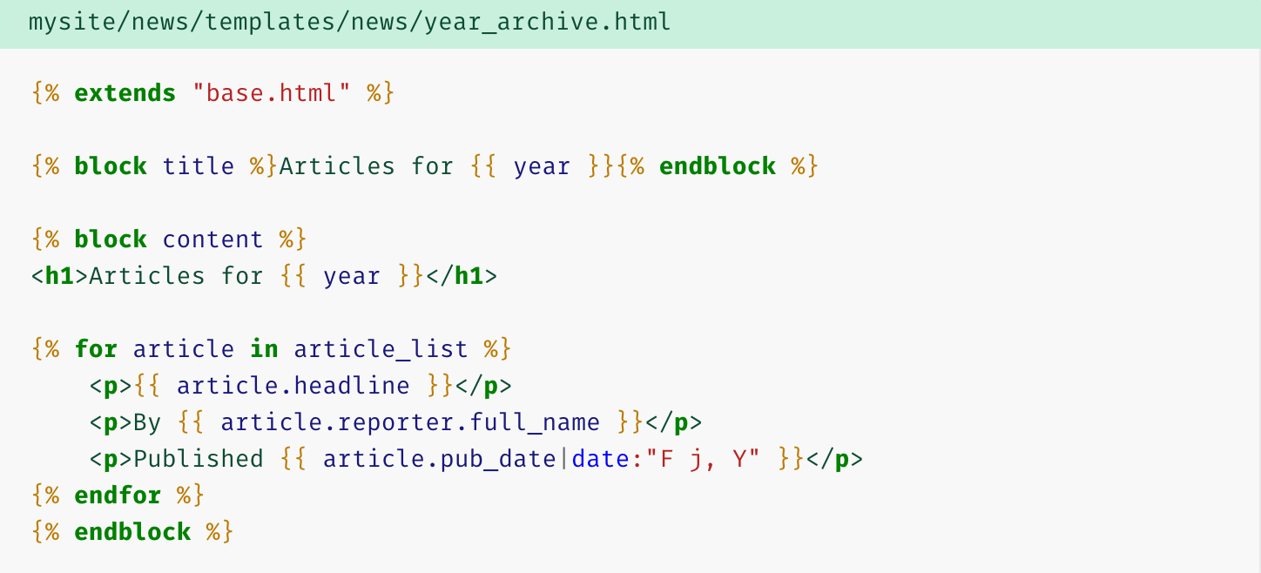
Perks of Django: Templating with Jinja
Jinja is a templating engine for Python

Slide 16
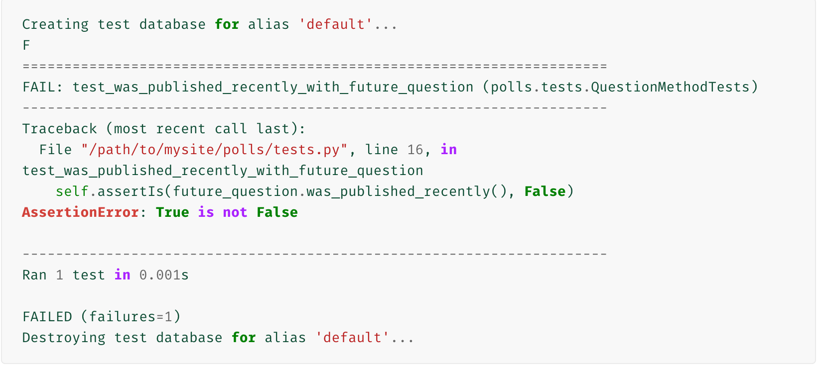
Perks of Django: Testing
Jacob Kaplan-Moss, one of Django’s original developers, says “Code without tests is broken by design.”
‘python manage.py test polls’ looks for tests in polls application (/polls/tests.py), creates a special db for the purpose of testing, looked for methods that began with ‘test’, and then informs us which tests failed

Slide 17
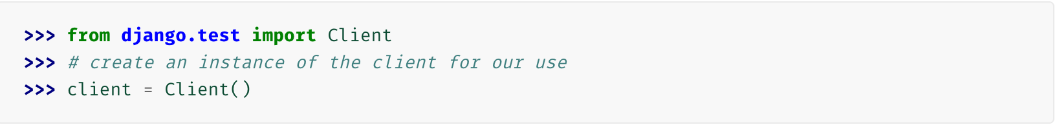
Perks of Django: Testing Part II
Django provides a test Client to simulate a user interacting with the code at the view level. We can use it in tests.py or even in the shell.

Slide 18
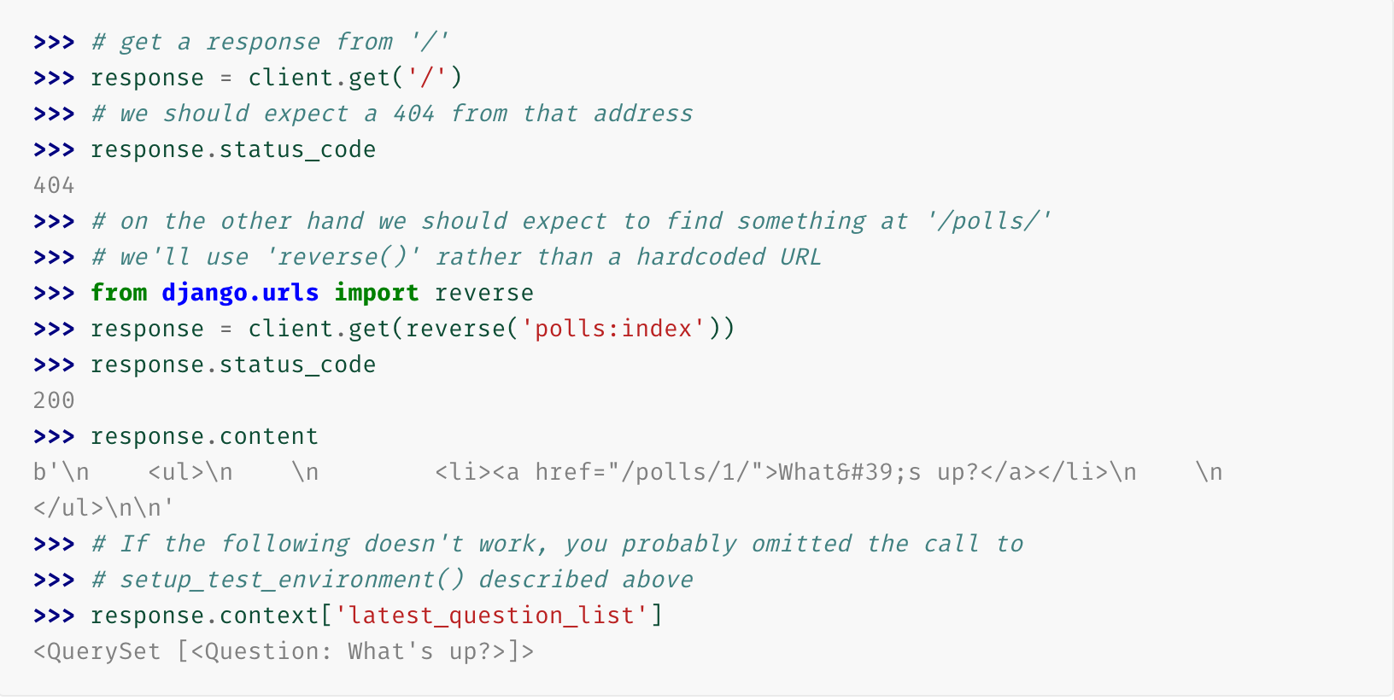

Slide 19
Databases
Can use postgresql, mysql, oracle, and more but sqlite3 is default
‘python manage.py migrate’ will look in DATABASES and create any db tables according to your settings in mysite/settings.py
‘sqlite3 db.sqlite3 .schema’ will shows the schema for your db
Each model is represented by a class that subclasses django.db.models.Model.
Each model has a number of class variables, each of which represents a database field in the model.
‘makemigrations’ tells Django that you’ve made some changes to your models and that you’d like the changes to be stored as a migration.
‘sqlmigrate’ takes migration names and returns their SQL:
‘check’ checks for any problems in your project without making migrations or touching db

Slide 20
Django Shell
Run shell with ‘python manage.py shell’
Return all objects of type model - ‘Question.objects.all()’
Returns something like ‘<QuerySet [<Question: Question object>]>’
By implementing __str__ method, you can change its result
Make an object - ‘q = Question(question_text=”What’s new?”)
Save object into db - ‘q.save()’
Access object’s id - ‘q.id’
Access object’s member - ‘q.question_text
Filter object return by id - ‘Question.objects.filter(id=1)
Filter object return by text - ‘Question.objects.filter(question_text__startswith=’What’)

Slide 21
Django Admin
Run ‘python manage.py createsuperuser’ to create a user who can log on to the admin site
Register your models in admin.py to give your model an interface - ‘from .models import Question’ and ‘admin.site.register(Question)’

Slide 22
Django Generic Views
Writing Web applications can be monotonous, because we repeat certain patterns again and again.
ListView - display a list of objects
DetailView - display a detail page for a particular type of object

Slide 23
Learning Resources
Python:
Udacity’s Programming Foundations with Python -- Very Light
Udacity’s Intro to Computer Science -- Very Thorough
Dive Into Python -- Free E-Book
Django:
Django Documentation
PythonProgramming.net -- Amazing Django video tutorials
JavaScript/HTML&CSS/Front-End Frameworks
Udacity’s Intro to HTML and CSS
Udacity’s Responsive Web Design Fundamentals -- Bootstrap
Udacity’s JavaScript Basics
NOW BUILD SOMETHING!

